Slide 1




The Science of Successful Learning
Conal Holmes conal@primaryquiz.com

Slide 2
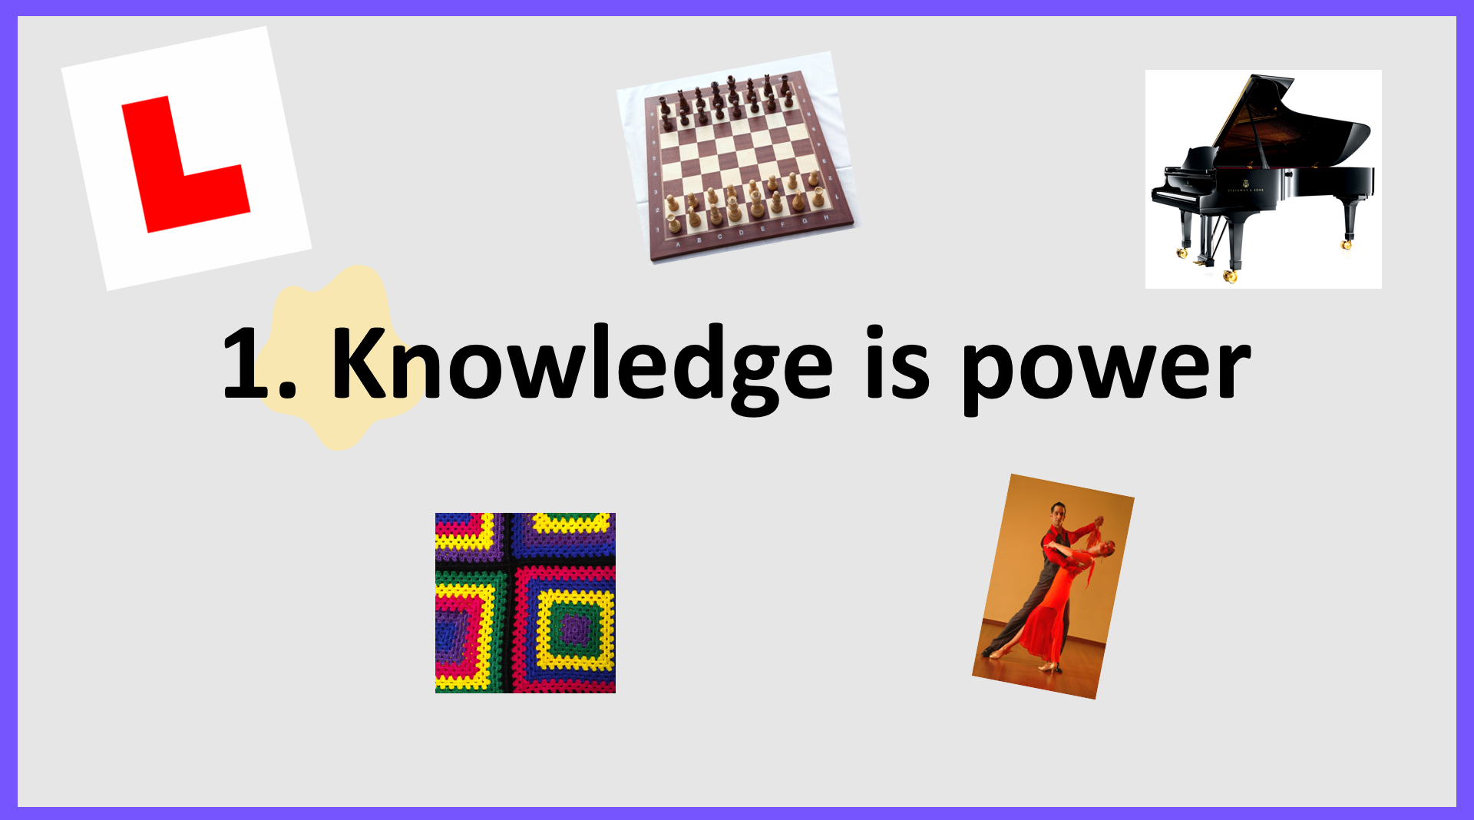
Seven reasons why…

Slide 3

Have a think about the following statements. How many can you work out?
1. A gas which is lighter than air.
2. The country whose origins date back to July 4th 1776.
3. The planet which has the shortest year.
4. The number of days ships were ‘quarantined’ for in 14th century Venice because of the plague.
5. The group of islands is located 300 miles off the coast of Argentina.
6. The singer-song writer who grew up on a Christmas tree farm in Pennsylvania, has won four Grammy Awards for Album of the Year and has a surname which is a type of bird.

Slide 4
Have a think about the following statements. How many can you work out?
1. A gas which is lighter than air – HELIUM / HYDROGEN
2. The country whose origins date back to July 4th 1776.- UNITED STATES
3. The planet which has the shortest year. - MERCURY
4. The number of days ships were ‘quarantined’ for in 14th century Venice because of the plague. - FORTY
5. The group of islands is located 300 miles off the coast of Argentina. - FALKLANDS
6. The singer-song writer who grew up on a Christmas tree farm in Pennsylvania, has won four Grammy Awards for Album of the Year and has a surname which is a type of bird. – TAYLOR SWIFT
1. We make informed choices based on knowledge we have already acquired.

Slide 5

2. Knowledge attracts new knowledge…
New knowledge will stick to knowledge we already have like “mental Velcro”.
Therefore, the more knowledge we have, the easier it becomes to acquire new knowledge.
Which group of children will be most adversely affected?

Slide 6









3. Having prior knowledge helps us learn faster…
Children must have the prior knowledge necessary to learn new ideas.
A child with more prior knowledge will acquire new knowledge more rapidly than a child with less.
What will happen to our learning gap?

Slide 7
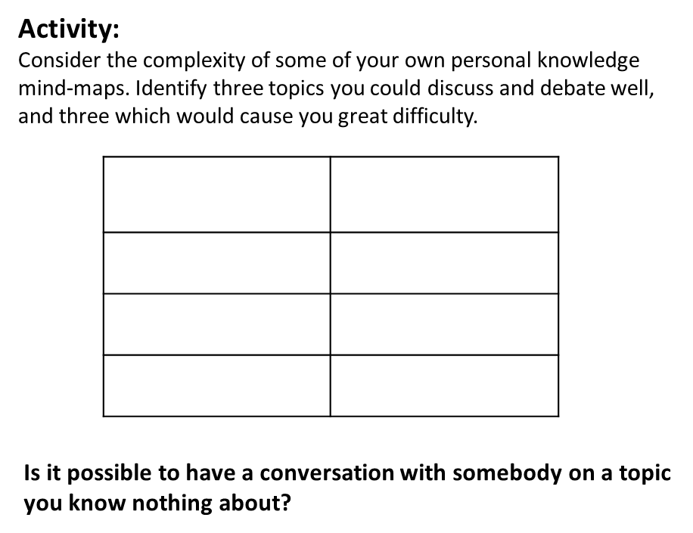

4. The more knowledge we have about a subject, the more complex our thought processes can become.
5. Knowledge acquisition will enable children to think, discuss and debate.
Should we keep animals in zoos?
Should mobile phones be allowed in schools?
How important was the River Nile to the ancient Egyptians?
What was ancient Greece’s legacy on the western world?

Slide 8
6. Having lots of knowledge makes us intelligent.
Intelligence; ‘The accrual and fine-tuning of many small parts of knowledge’
“The difference between novices and experts is that experts have a huge body of background knowledge and processes stored in long-term memory, and have spent a huge amount of time practising using that knowledge and those processes. In most fields, it takes several years and thousands of hours to become an expert.
We can not develop pupil expertise simply by getting them to think like scientists or historians. Any lesson in which teachers focus on getting children to behave like experts rather than the building blocks of knowledge is a lesson wasted.”
Daisy Christodolou, 7 Myths about Education

Slide 9
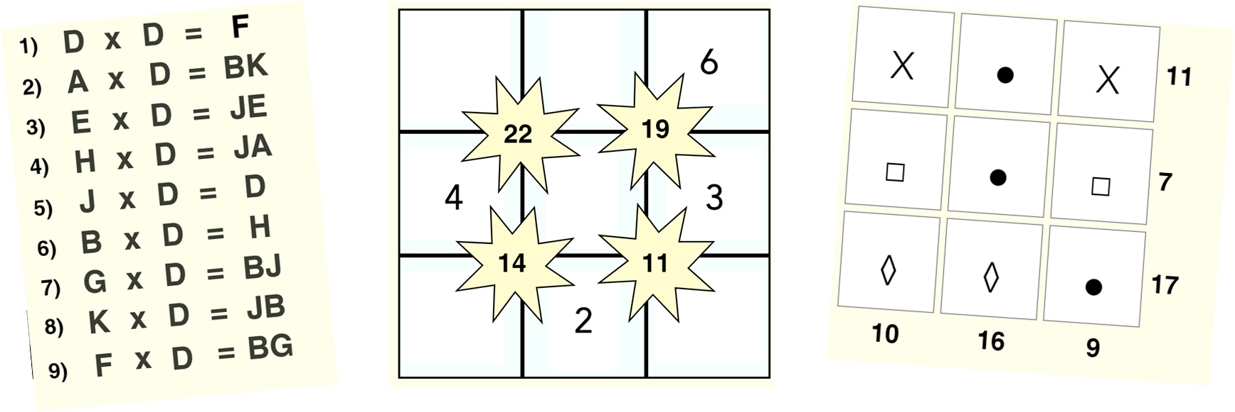
7. Having knowledge enables us to solve new problems.
Mastery; ‘Having knowledge and knowing how to use it.’

Slide 10

Why do we need knowledge?
Knowledge enables us to learn new skills.
Knowledge enables us to think, discuss, debate, question and challenge.
Knowledge attracts new knowledge.
Knowledge provides us with the strategies we need to solve new problems
Knowledge enables us to understand at a more complex level.
Knowledge enables us to see links, insights, similarities and differences.
Knowledge enables us to develop opinions and draw conclusions.
Having knowledge makes us more intelligent.
Knowledge leads to mastery.

Slide 11
Progress
“Knowing more and remembering more over time.”

Slide 12
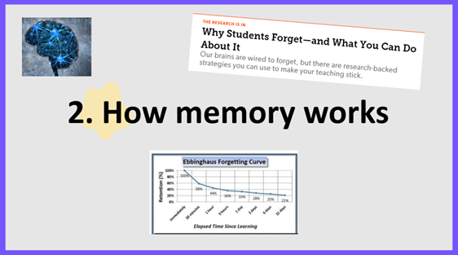

Slide 13
Some New Learning
gongoozler | tyrotoxism | dompteuse | pandiculation | sciapodous
phenakism | nihilarian | mesonoxian | pronk | agraffe
Having huge feet
Someone who watches but does nothing
A woman who trains animals
Wire that holds cork in a champagne bottle
A person who deals with things that lack importance
To be poisoned by cheese
Stretching or yawning before waking up
At midnight
Deception or trickery
A weak or foolish person

Slide 14
Some New Learning
gongoozler | tyrotoxism | dompteuse | pandiculation | sciapodous
phenakism | nihilarian | mesonoxian | pronk | agraffe
Having huge feet
Someone who watches but does nothing
A woman who trains animals
Wire that holds cork in a champagne bottle
A person who deals with things that lack importance
To be poisoned by cheese
Stretching or yawning before waking up
At midnight
Deception or trickery
A weak or foolish person

Slide 15
Gongoozler:
Tyrotoxism:
Dompteuse:
Pandiculation:
Sciapodous:
Phenakism:
Nihilarian:
Mesonoxian:
Pronk:
Agraffe:
Some New Learning
Someone who watches but does nothing
To be poisoned by cheese
A woman who trains animals
Stretching or yawning after waking up
Having huge feet
Deception or trickery
A person who deals with things that lack importance
At midnight
A weak or foolish person
Wire that holds cork in a champagne bottle
As an educator, what would be my main considerations around new learning?

Slide 16
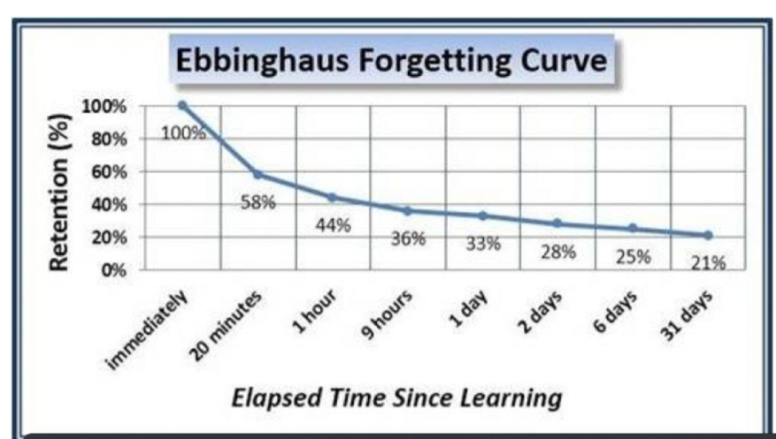
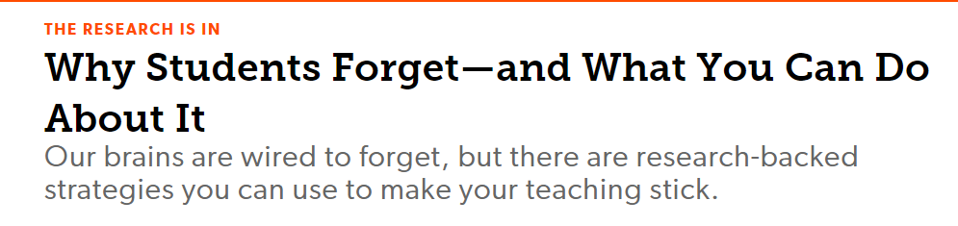

Our brains are wired to forget

Slide 17
When is learning more memorable?
When it relates to a personal experience.
When it triggers an emotional response
When we revisit it.
When we have fun learning about it.
When we have strong prior knowledge.
When we understand the context.
When we’re able to build connections.

Slide 18
Building Connections
B
Equilateral
Equi = equal
Lateral = side
Scalene
Skalenos = unequal (Greek)
Skolios = bent (Latin
A
C
Isosceles
Isos = equal
Skelos = legs

Slide 19
Short Term Memory
Try this…

Slide 20
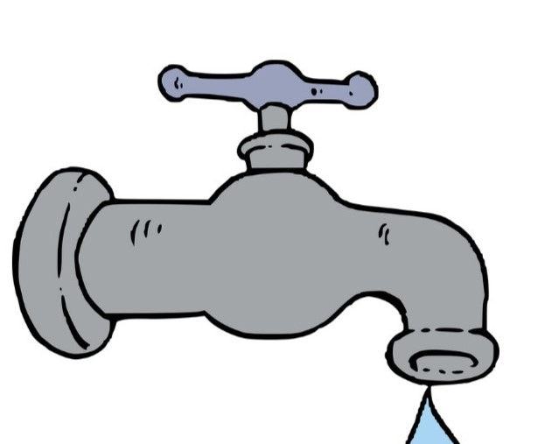
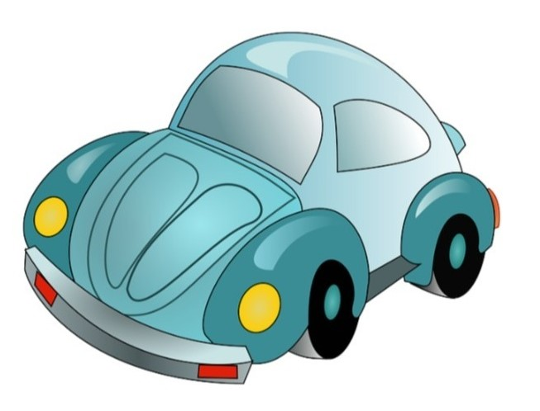


Slide 21
Put them in alphabetical order…

Slide 22

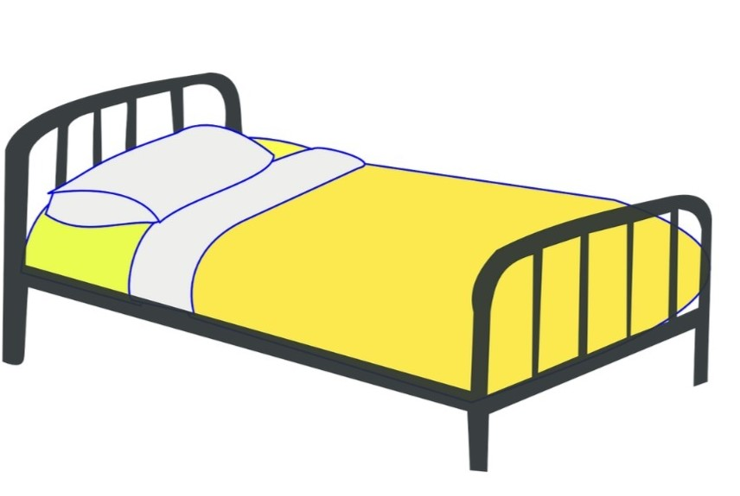



Slide 23
Put them into reverse alphabetical order.

Slide 24




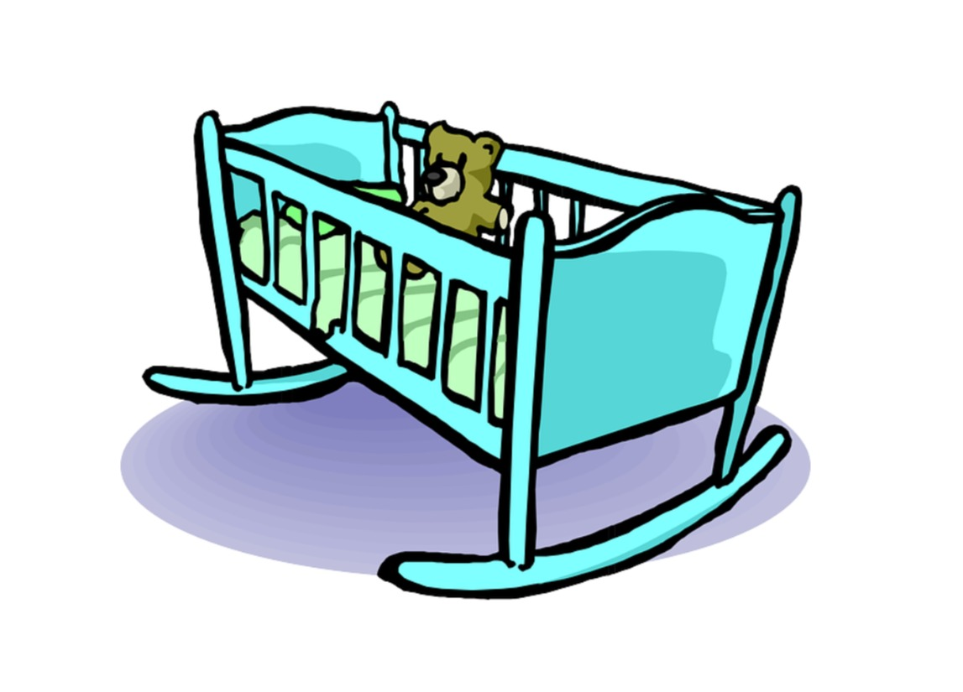

Slide 25
Put them in alphabetical order…

Slide 26
2148731295742386

Slide 27
1066181219141939

Slide 28
Short Term Memory
Information held is instantly forgotten (30 seconds)
Essential for decision making, problem-solving and other cognitive tasks.
Also known as ‘working memory’
Very limited – can hold only a few pieces of information at once
Can be easily overloaded, seriously impeding next-step learning
The temporary storage and manipulation of information.
A cognitive system for holding and processing information for a few seconds to about a minute.
Adversely affected by worry, anxiety or stress
Children spend 90%+ of time in a classroom engaged in activities which require use of short-term memory.

Slide 29
Learning
The transferal of information from working memory to long-term memory.
“Acquiring knowledge and skills and having them readily available from memory so you can make sense of future problems and opportunities.”
Learning: “An alteration in long-term memory. If nothing has been altered in long-term memory, nothing has been learned.”

Slide 30
Long Term Memory
Can hold an unlimited amount of information
Information can be held for an unlimited amount of time.
Crystallized intelligence
Information can be ‘retrieved’ from long term memory back into short term memory.
Retrieving the information rebuilds the neural pathway and strengthens the memory.
Providing children with activities which require them to use long-term memory is key to remembering new learning.

Slide 31
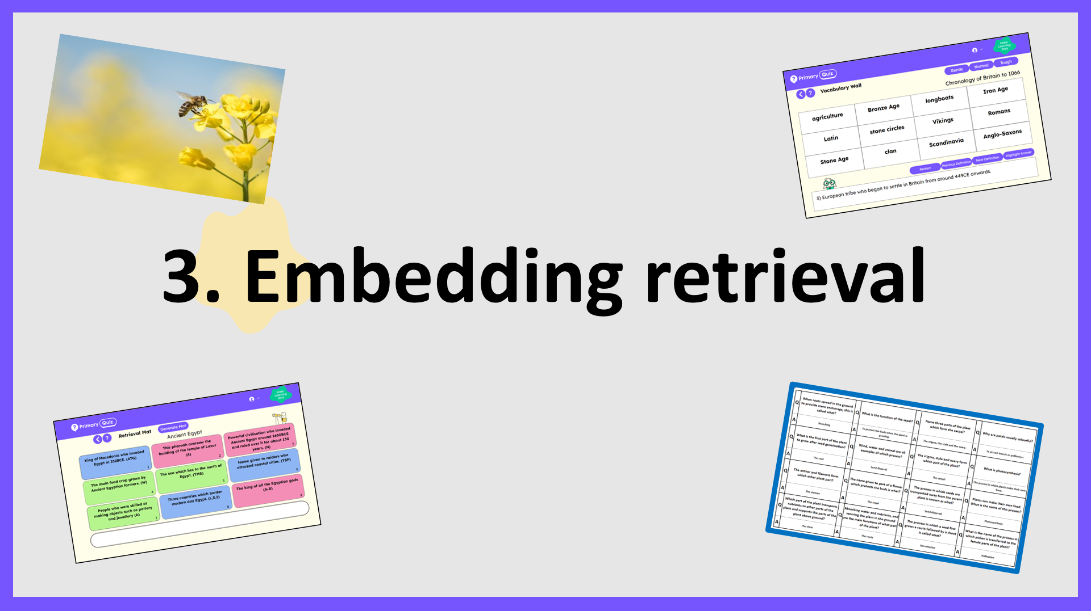

Slide 32
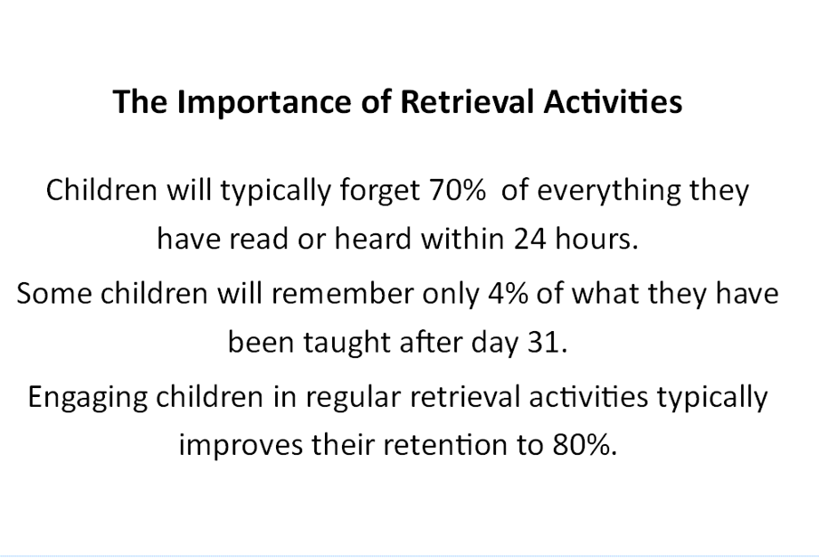
The Importance of Retrieval Activities
Aristotle:
Exercise in repeatedly recalling a thing strengthens the memory

Slide 33
Retrieval – Why it Works
When we retrieve memories, we focus on reconstructing the pathway to the stored information. We go through a sequence of neural activities required to bring the information to mind.
Make it effortful
Provide
feedback
Offer scaffolding and support.

Slide 34
An Analogy for Retrieval: Our Journey to Work
Mentally recreate your journey to work.
Visualise your journey from the moment you leave your driveway to the moment you arrive.
Every junction,
Every roundabout,
Significant buildings
Every bridge
Every set of traffic lights
How much can you reconstruct?
Which parts of the journey are easier to remember?
Are there any parts of the journey that are difficult to reconstruct?
If so, why do you think this is?
It’s about the journey – not just the destination.

Slide 35

Revisiting Newly Learned Content
Let’s Cook!
Think about the process you would go through when following a recipe for the first time.
Do we read the different steps, memorize the information, close the book and begin to cook?
How many times would we need the recipe before we could cook the meal from memory?

Slide 36
Use low-stakes quizzes.
Supports pupils who are less confidence and more anxious.
Supports learning rather than measures it.
The Benefits of Low Stakes Quizzing
Challenges memory and strengthens long-term retention.
Challenges more able pupils.
Pupils spot their own mistakes, gaps in knowledge and misconceptions.
Provides 3-5 minutes of daily practice. It’s how we learn best.
Includes all pupils.
Provides opportunities for spaced learning.
Stimulates discussion and debate.
Fosters teamwork and collaboration.
Interrupts the forgetting process.
It’s fun!
It’s the deepest form of learning that there is.

Slide 37
Strategies for Embedding Retrieval
Revisit newly learned content at least two more times.
Provide problems without solutions.
cramming
Use mistakes.
re-reading
Encourage reflection on personal experiences.
Use low-stakes quizzes.
Mix up the practice.
Provide high levels of challenge.

Slide 38
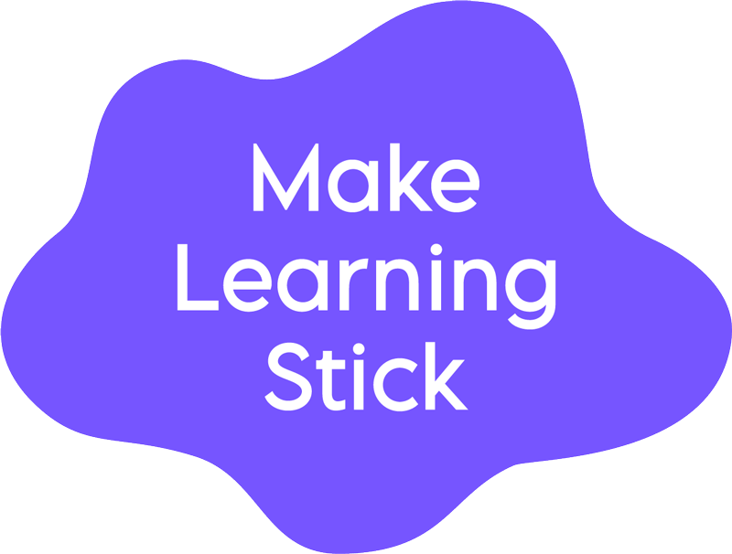
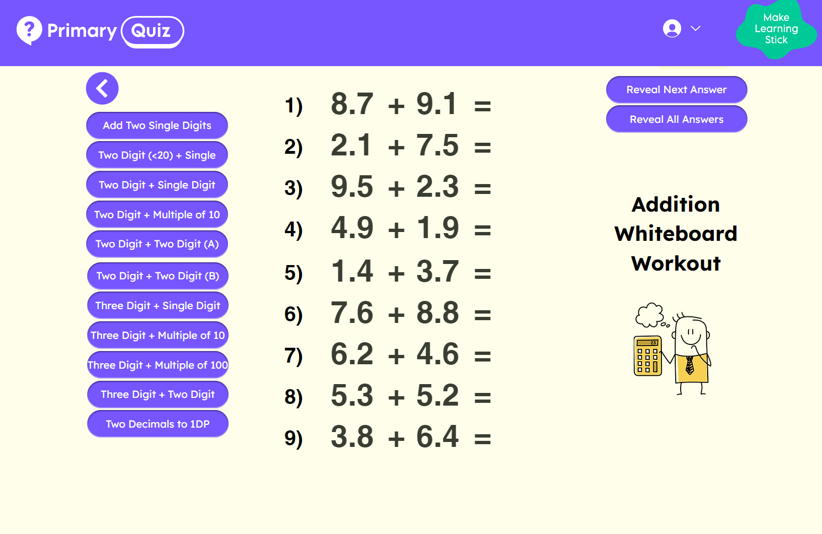
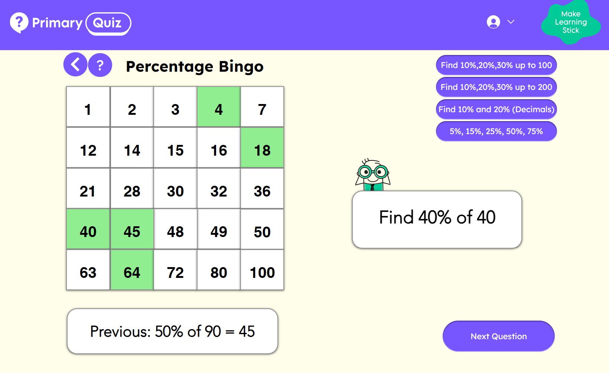
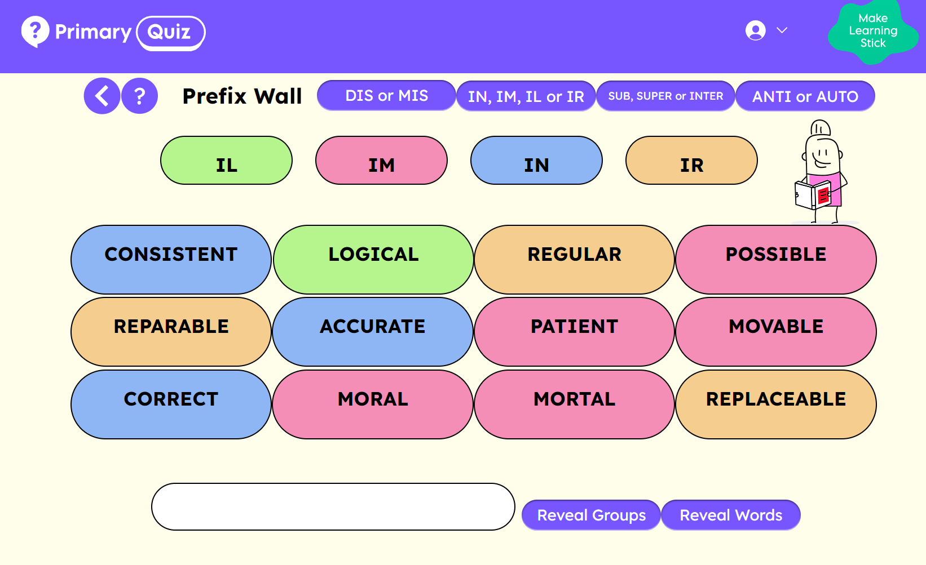
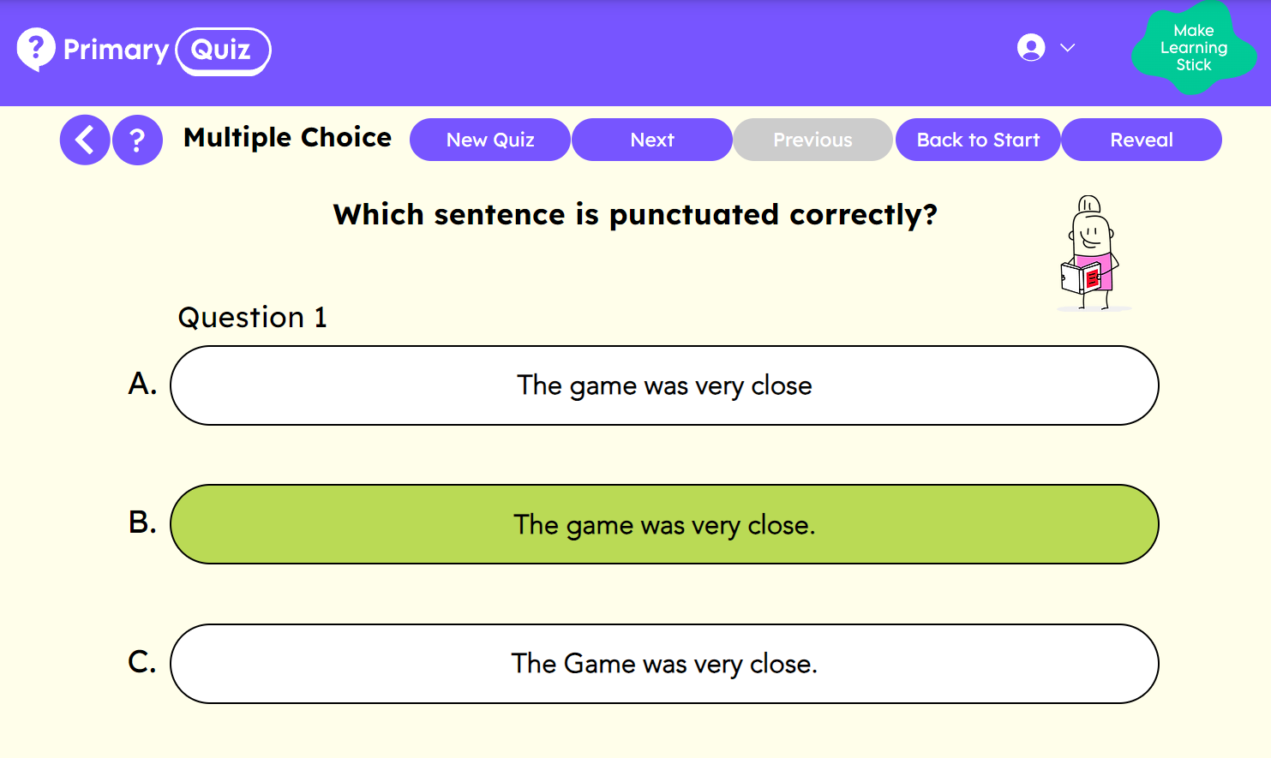
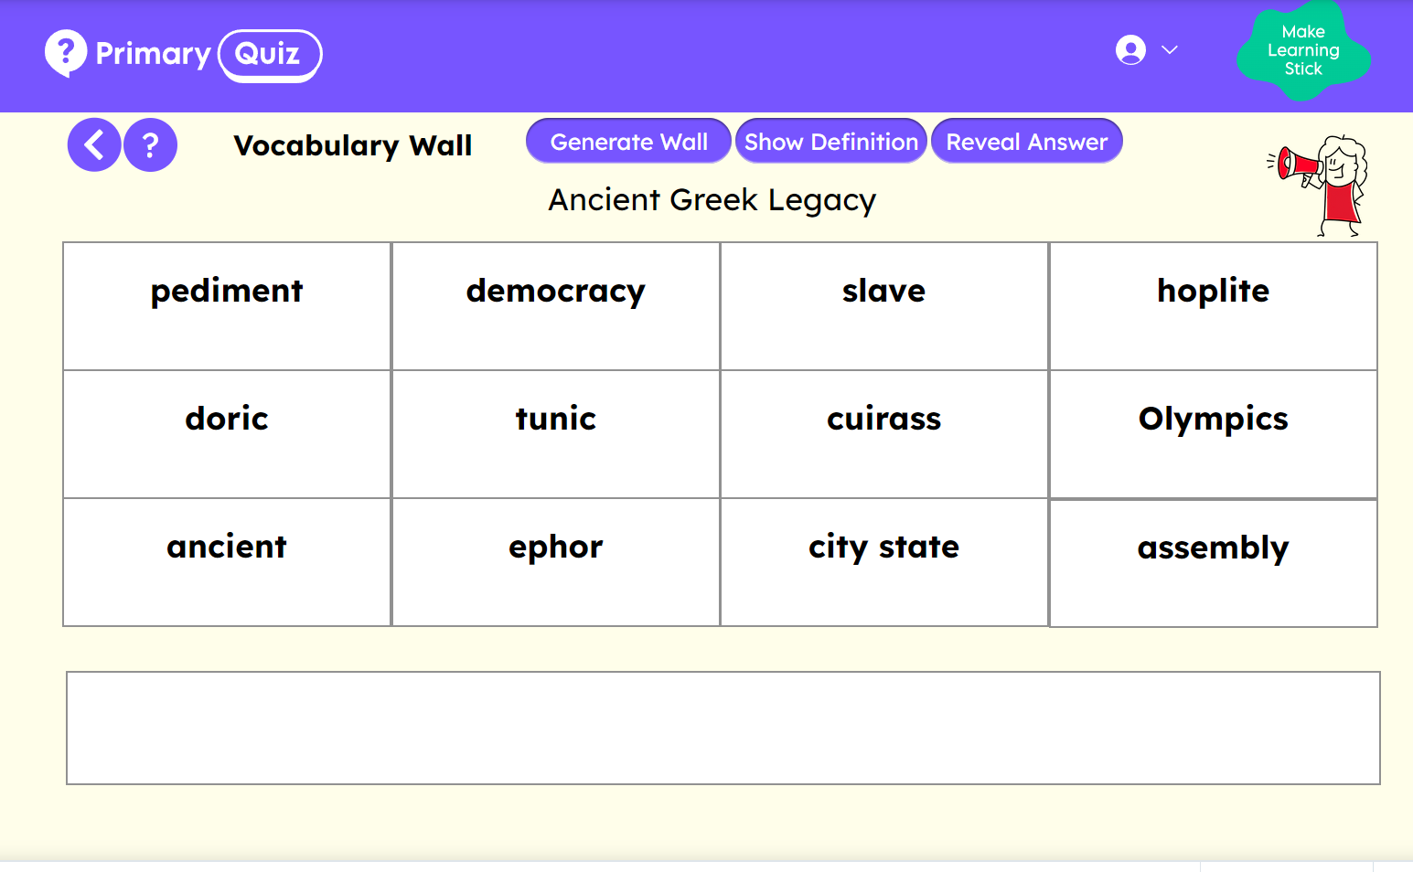
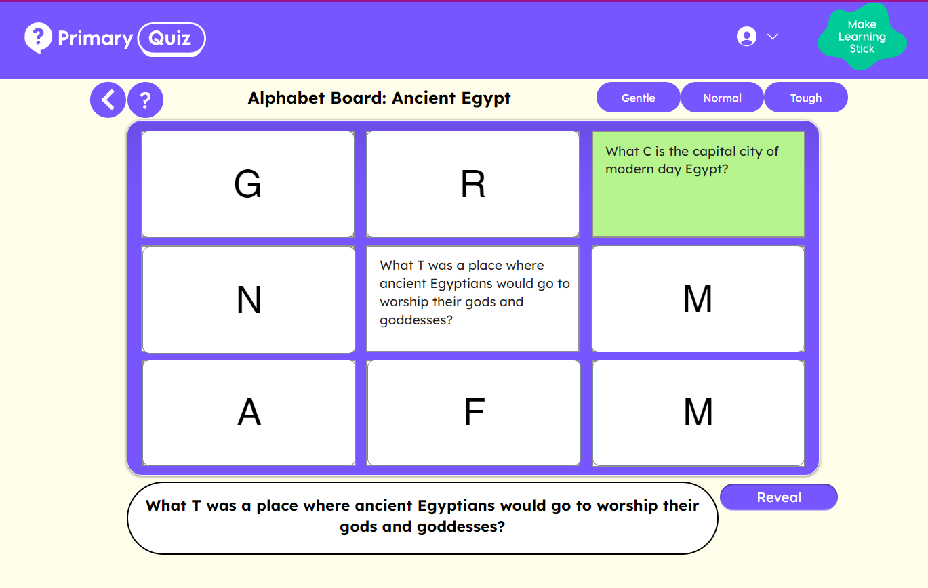
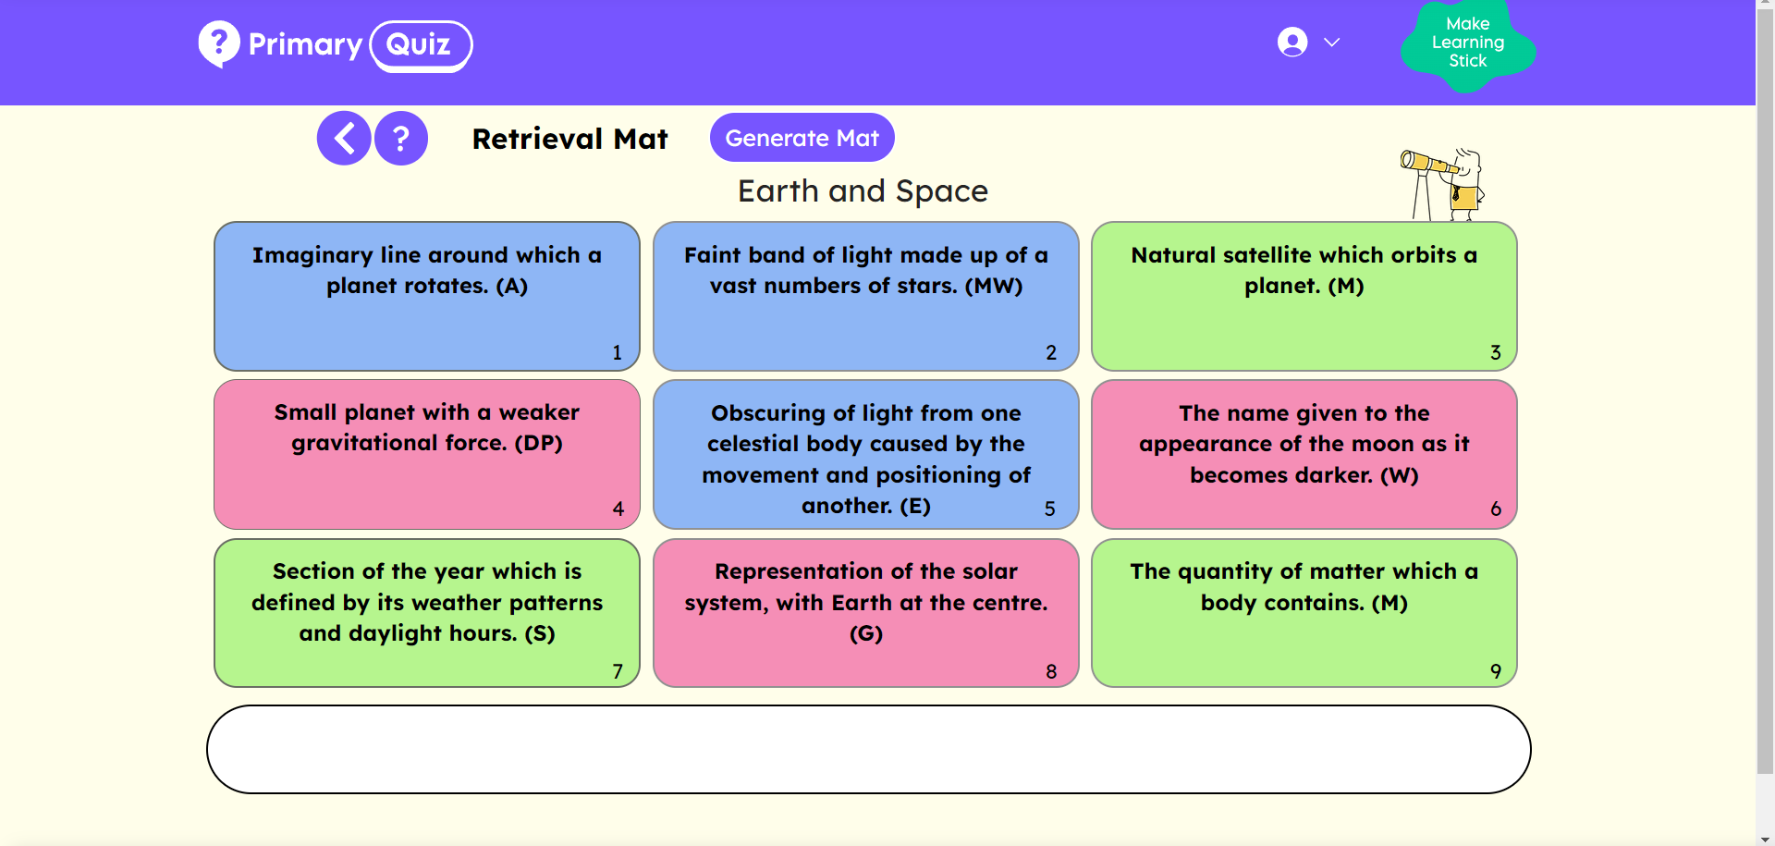
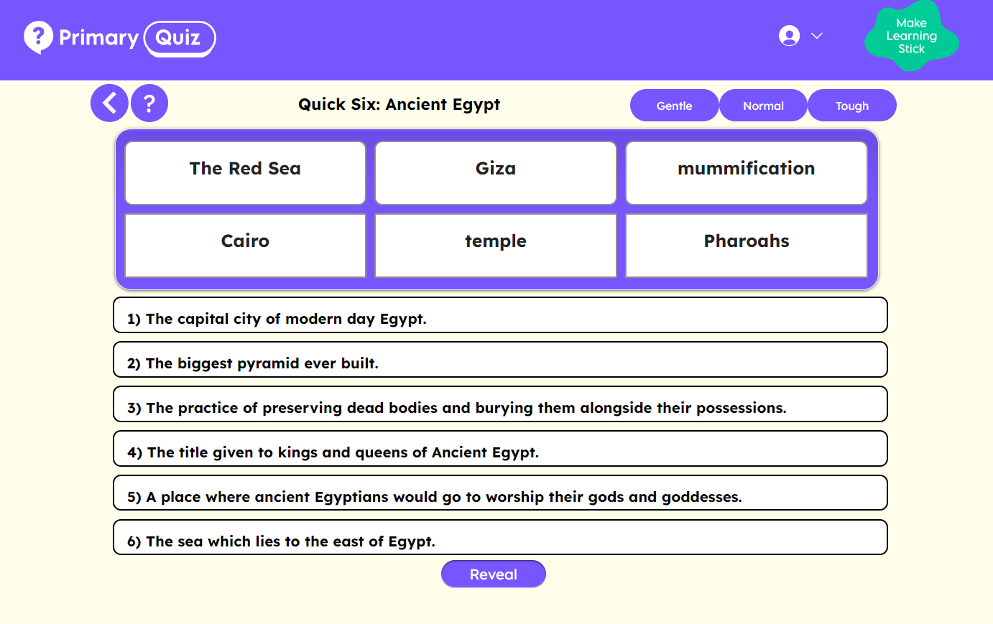

Primary Quiz
conal@primaryquiz.com
Find out more at www.primaryquiz.com
Hundreds of low-stakes quizzes to help you embed retrieval strategies into your lessons.

Slide 39

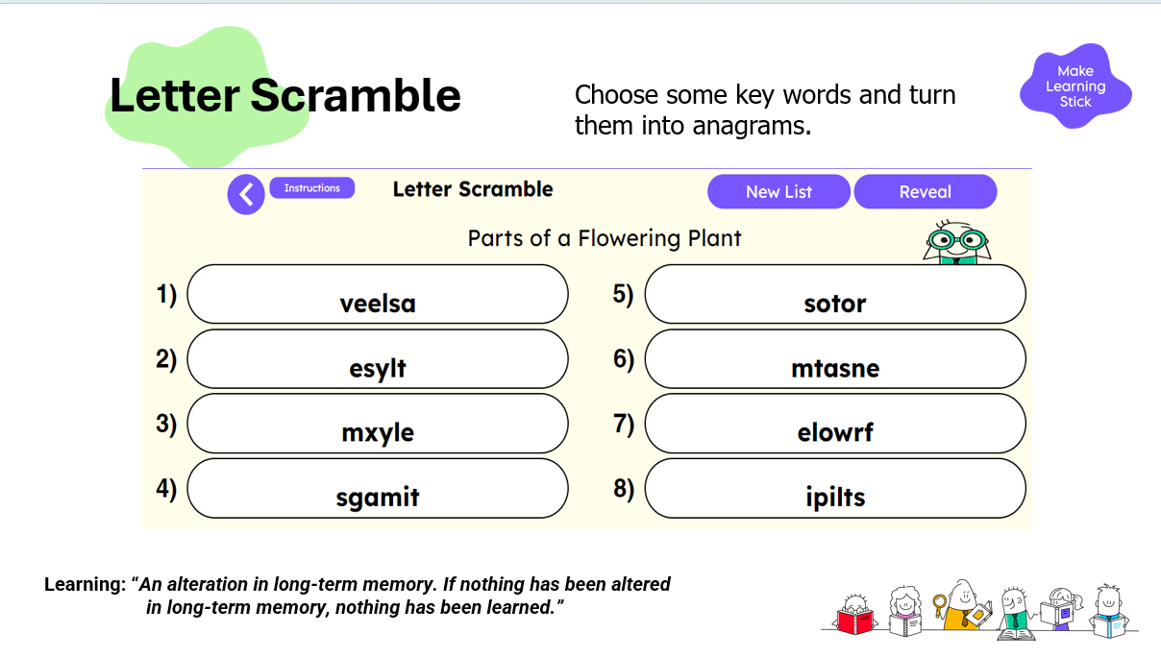
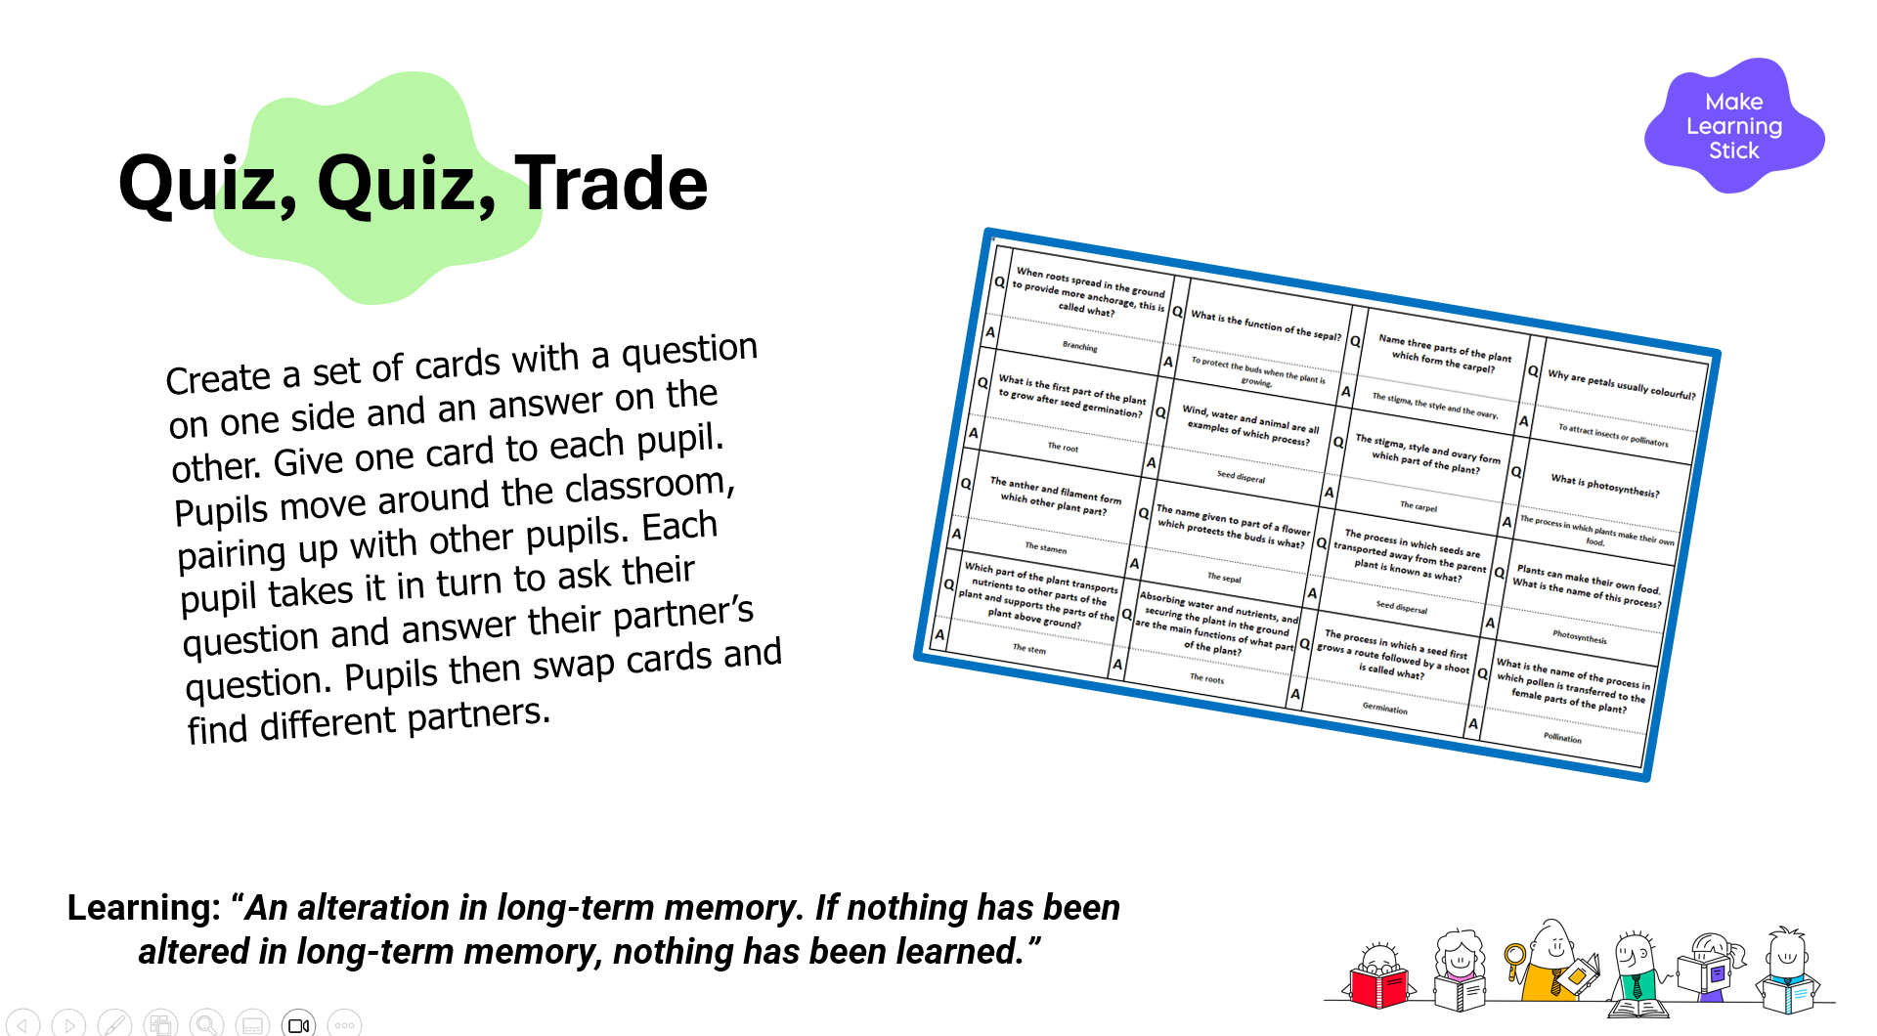
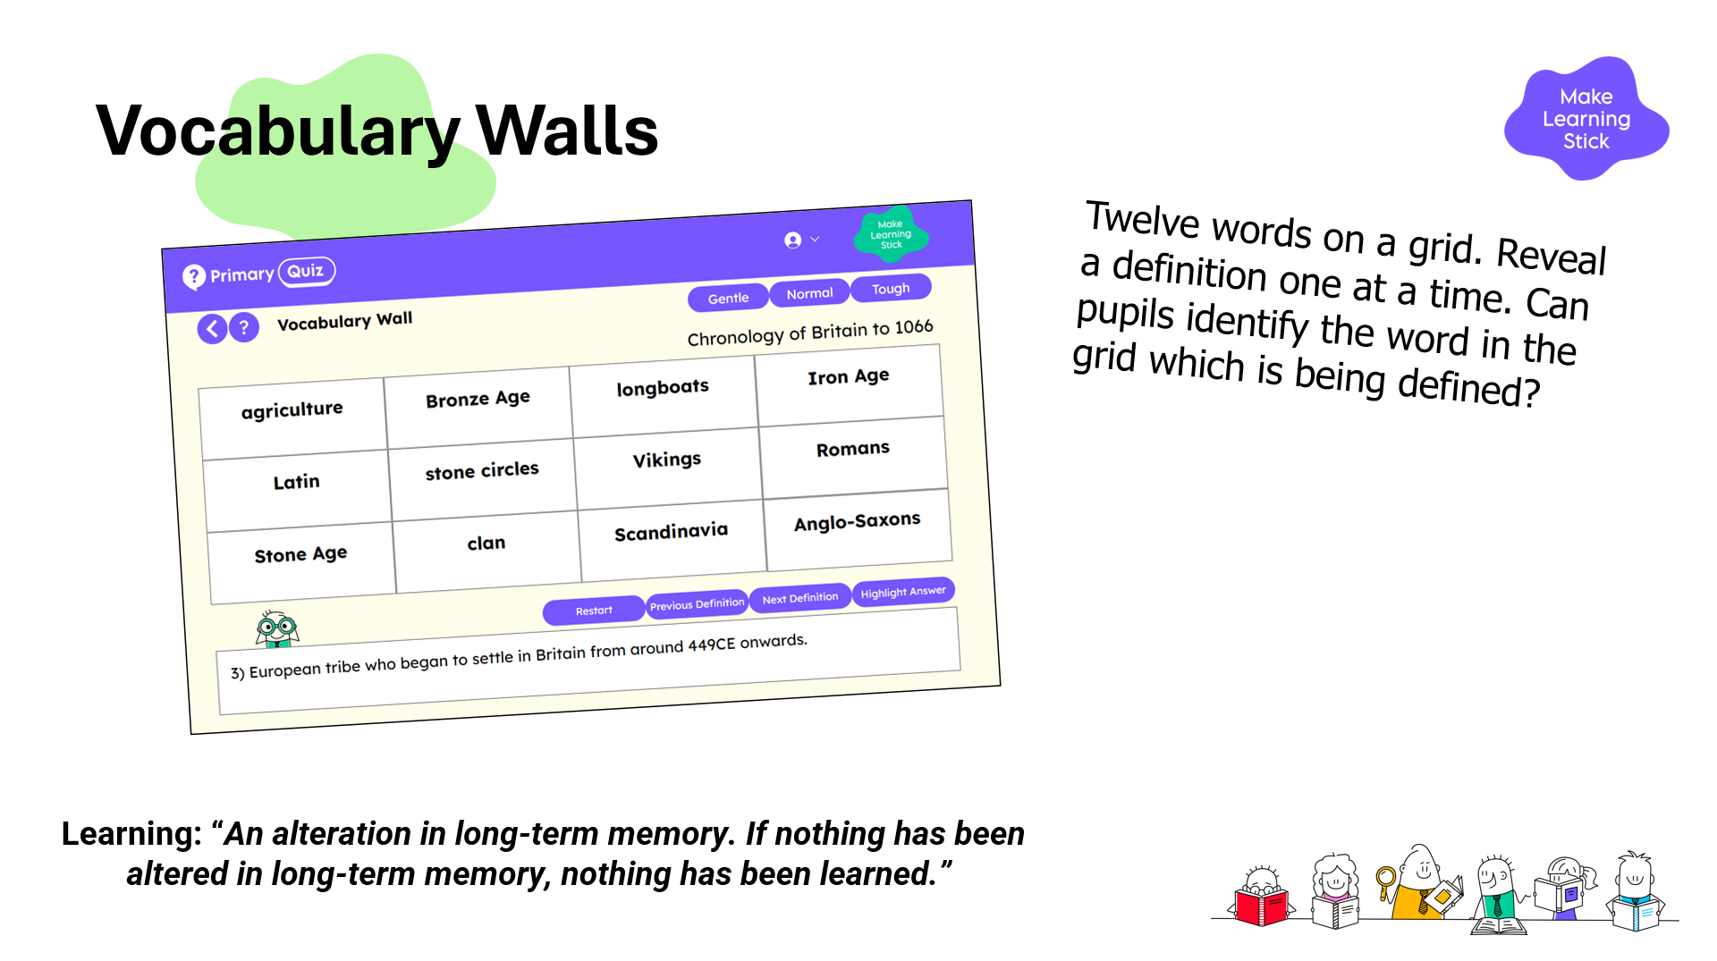
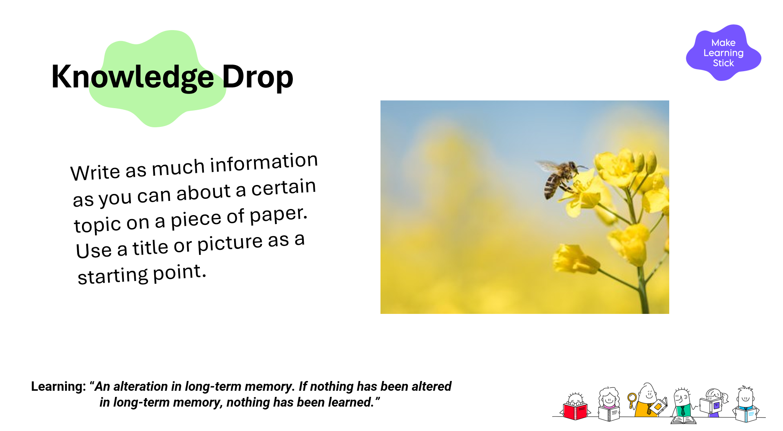
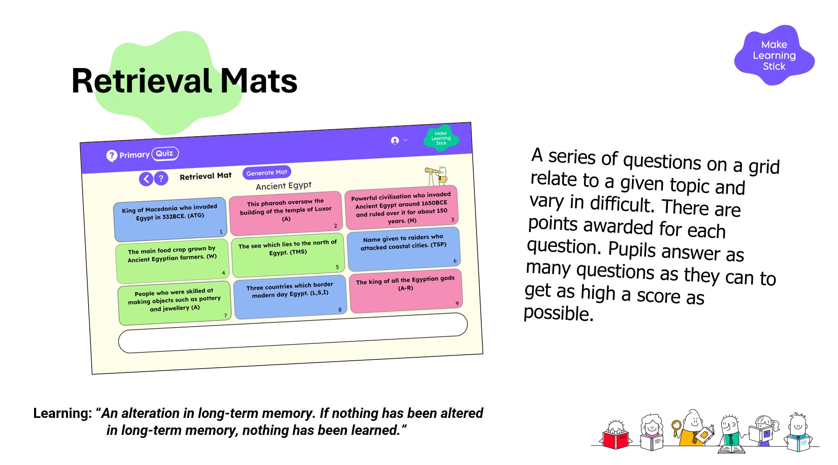
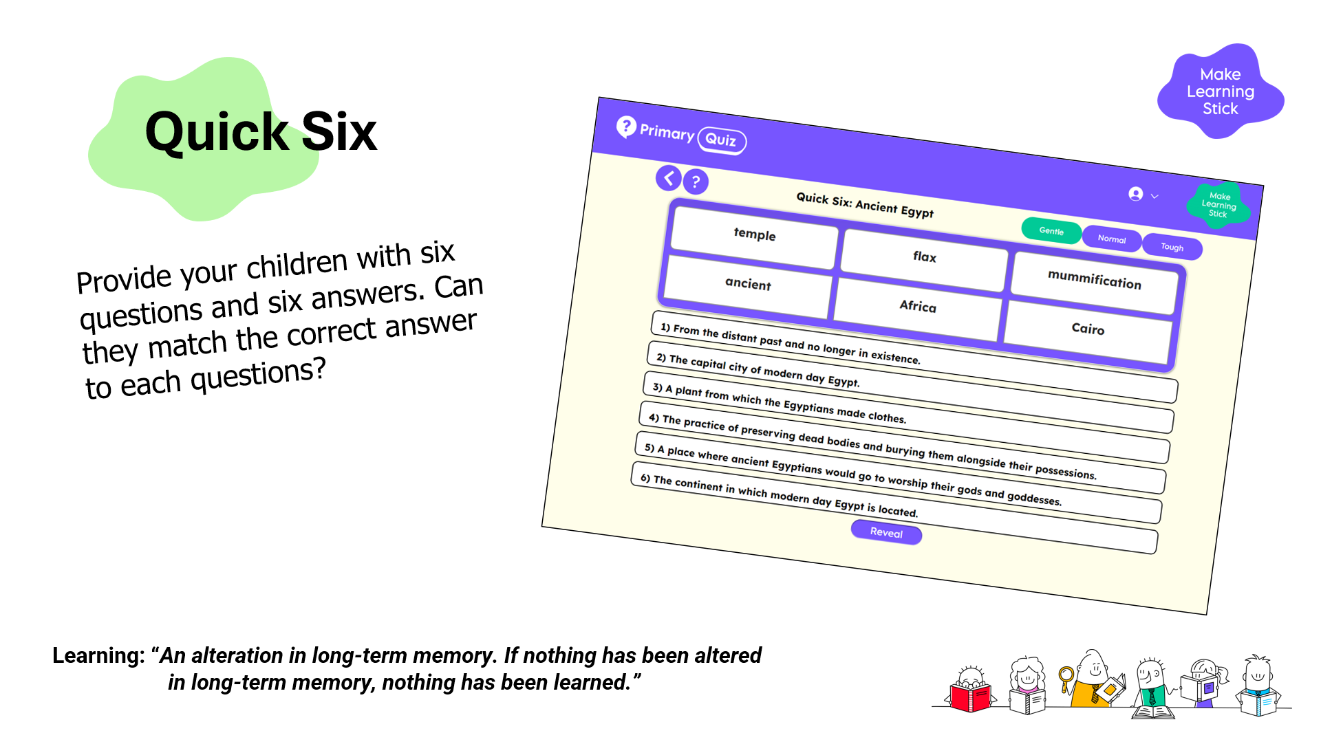
Retrieval
Some Practical Ideas…

Slide 40
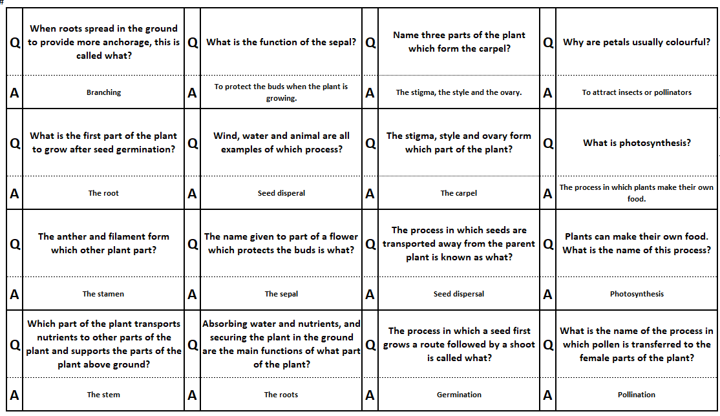
Quiz, Quiz, Trade
Create a set of cards with a question on one side and an answer on the other. Give one card to each pupil. Pupils move around the classroom, pairing up with other pupils. Each pupil takes it in turn to ask their question and answer their partner’s question. Pupils then swap cards and find different partners.
Learning: “An alteration in long-term memory. If nothing has been altered in long-term memory, nothing has been learned.”

Slide 41
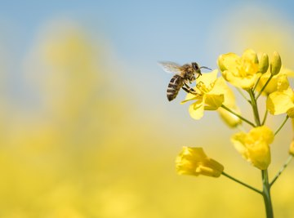
Knowledge Drop
Write as much information as you can about a certain topic on a piece of paper. Use a title or picture as a starting point.
Learning: “An alteration in long-term memory. If nothing has been altered in long-term memory, nothing has been learned.”

Slide 42
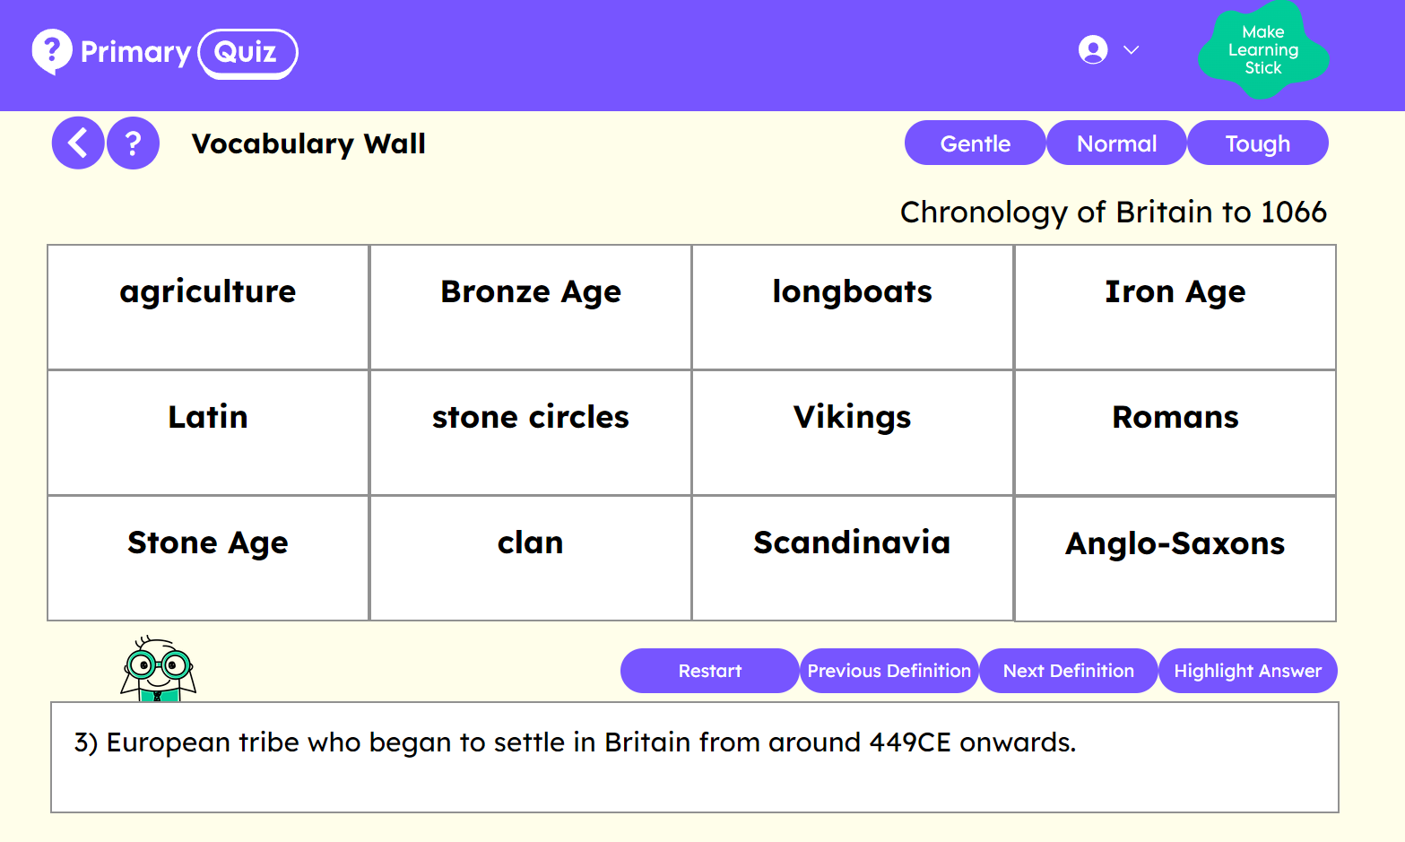
Vocabulary Walls
Twelve words on a grid. Reveal a definition one at a time. Can pupils identify the word in the grid which is being defined?
Learning: “An alteration in long-term memory. If nothing has been altered in long-term memory, nothing has been learned.”

Slide 43
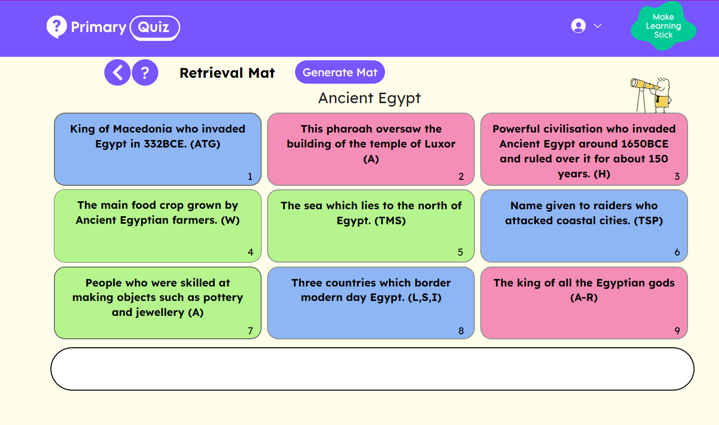
Retrieval Mats
A series of questions on a grid relate to a given topic and vary in difficult. There are points awarded for each question. Pupils answer as many questions as they can to get as high a score as possible.
Learning: “An alteration in long-term memory. If nothing has been altered in long-term memory, nothing has been learned.”

Slide 44
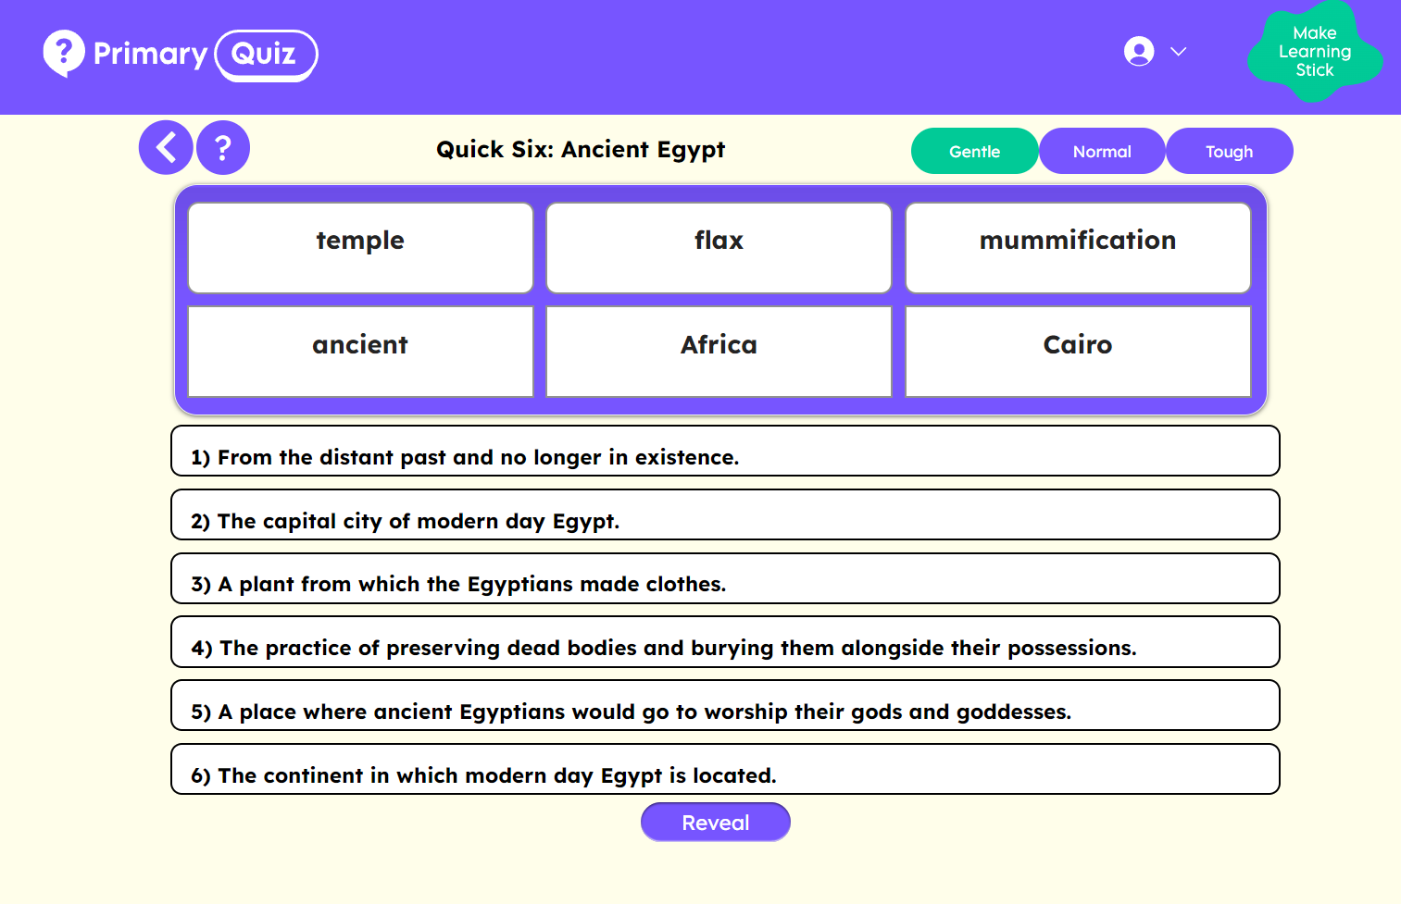
Quick Six
Provide your children with six questions and six answers. Can they match the correct answer to each questions?
Learning: “An alteration in long-term memory. If nothing has been altered in long-term memory, nothing has been learned.”

Slide 45
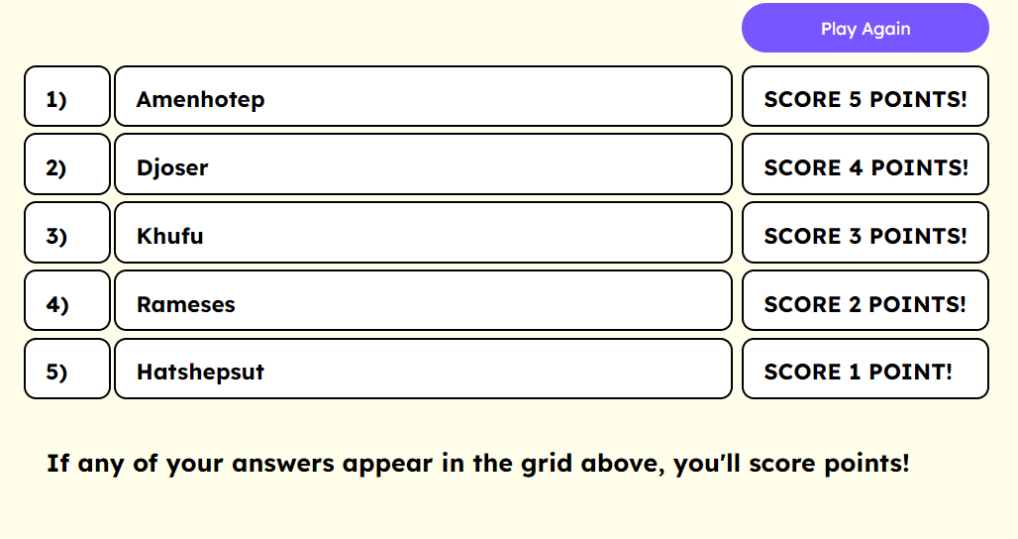
Give Me 5!
Ask pupils to give you 5 examples of something related to your topic (planets, pharaohs, continents)
Make your own list. Pupils score points if their answers appear on your list.
Learning: “An alteration in long-term memory. If nothing has been altered in long-term memory, nothing has been learned.”

Slide 46
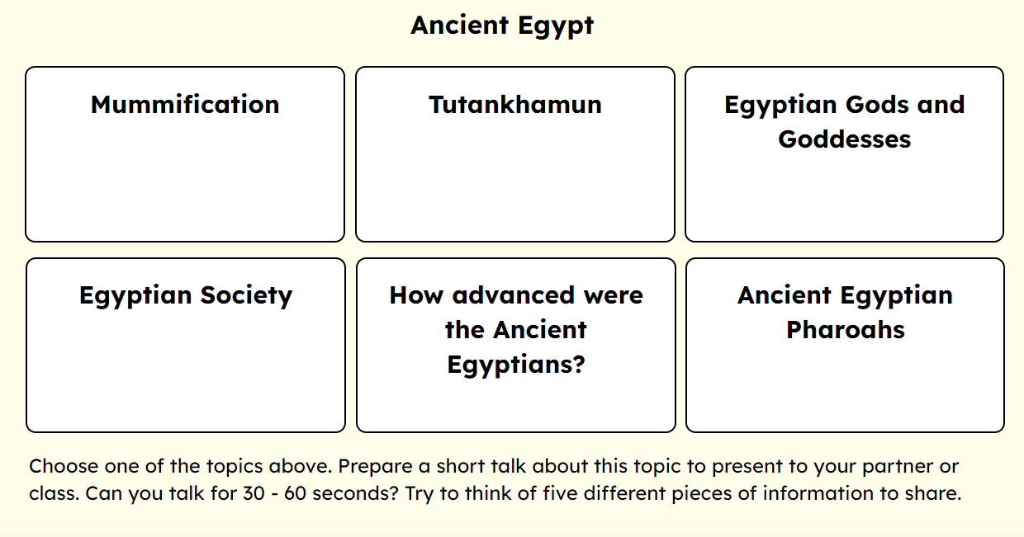
Speak Like an Expert
Choose a topic. Prepare a short presentation on your chosen topic. Can you present three to five pieces of information?
Learning: “An alteration in long-term memory. If nothing has been altered in long-term memory, nothing has been learned.”

Slide 47
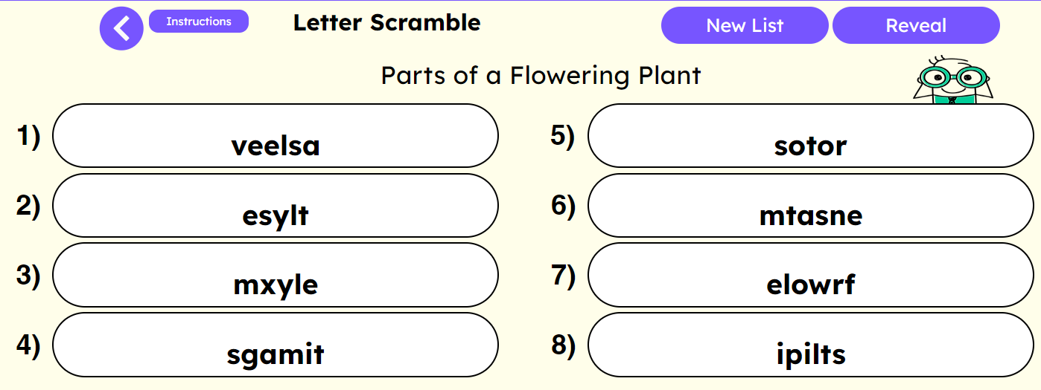
Letter Scramble
Choose some key words and turn them into anagrams.
Learning: “An alteration in long-term memory. If nothing has been altered in long-term memory, nothing has been learned.”

Slide 48
Primary Quiz
conal@primaryquiz.com
Find out more at www.primaryquiz.com
Hundreds of low-stakes quizzes to help you embed retrieval strategies into your lessons.

Slide 49
* Immediate and unlimited access to Primary Quiz, starting today.
Primary Quiz for Webinar Attendees
1. CLAIM A FREE TRIAL – 14 DAYS OF UNLIMITED ACCESS (INCREASED FROM 7)
2. BOOK A 15 MINUTE DEMO AND GET PRIMARY QUIZ FREE FOR A MONTH
3. BUY PRIMARY QUIZ FOR YOUR SCHOOL AT DISCOUNTED PRICES
Receive a 20% discount off a one-year Primary Quiz subscription. (£395 instead of £495!)
Three years of Primary Quiz for just £1035 (reduced from £1185)
Get the rest of the summer term for free.
Special rates for small schools, Infant schools and MATs.
Get a free staff meeting on The Science of Successful Learning.
Email conal@primaryquiz.com for further information on any of the above.

Slide 50
Email: conal@primaryquiz.com
Tel: 01244 735110
Interested in booking this training for your school, MAT or cluster?

